Slide 1
Python Introduction
Presented By
S. Maheshwaran M.Sc

Slide 2
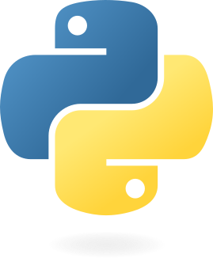
What is Python?
Python is a general-purpose, dynamically typed, high-level, compiled and interpreted, garbage-collected, and purely object-oriented programming language that supports procedural, object-oriented, and functional programming.

Slide 3
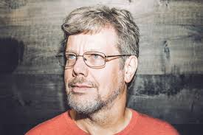
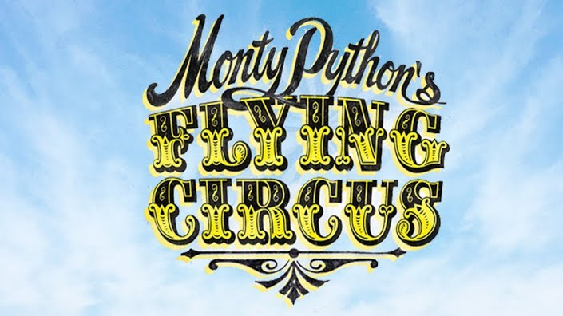
Why the Name Python?
There is a fact behind choosing the name Python. Guido van Rossum was reading the script of a popular BBC comedy series "Monty Python's Flying Circus". It was late on-air 1970s.
Van Rossum wanted to select a name which unique, sort, and little-bit mysterious. So he decided to select naming Python after the "Monty Python's Flying Circus" for their newly created programming language.
The comedy series was creative and well random. It talks about everything. Thus it is slow and unpredictable, which made it very interesting.
Python is also versatile and widely used in every technical field, such as Machine Learning, Artificial Intelligence, Web Development, Mobile Application, Desktop Application, Scientific Calculation, etc.

Slide 4
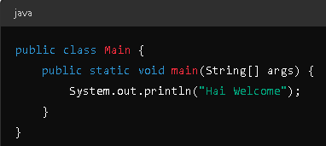

Python vs java
In Python, it is easy to learn and write code. While in Java, it requires more code to perform certain tasks.
Python is dynamically typed, meaning we do not need to declare the variable Whereas Java is statistically typed, meaning we need to declare the variable type.
Python is suitable for various domains such as Data Science, Machine Learning, Web development, and more. Whereas Java is suitable for web development, mobile app development (Android), and more.

Slide 5
Features of Python
Easy to Use
Easy to Read
Dynamically Typed
High-level
Compiled and Interpreted
Garbage Collected
Purely Object-Oriented
Cross-platform Compatibility
Rich Standard Library
Open Source

Slide 6
Why learn Python?
Learn Standard Library
GUI Programming Support
Integrated
Embeddable
Dynamic Memory Allocation
Libraries and Frameworks
Versatility
Large Community
Career Opportunities
High Demand
Increased Productivity
Big Data and Machine Learning

Slide 7
Where is python used?
Data Science
Desktop Applications
Consol-Based Applications
Mobile Applications
Software Development
Artificial Intelligence
Web Applications
Enterprise Applications
3D CAD Applications
Machine Learning
Computer Vision
Speech Recognition
Education
Gaming
IoT
Networking
DevOps
Finance
Audio & Music
Writing Scripts
Testing

Slide 8
Python Popular Frameworks & Libraries
Web development (Server-side)
GUIs based applications
Machine Learning
Mathematics
BeautifulSoup
Requests
SQLAlchemy
Kivy
Pygame
Pytest
Rest framework
FastAPI
Streamlit
NLTK

Slide 9
Tips to Keep in Mind While Learning Python
Make it Clear Why We Want to Learn
Learn the Basic Syntax
Write Code by Own
Keep Practicing
Make Notes as Needed
Discuss Concepts with Other
Do small Projects
Teach Others
Explore Libraries and Frameworks
Contribute to Open Source

Slide 10
thankyou

